Slide 1





Consumer Goods
Ad-hoc insights
Understand consumer trends for a competitive edge
By: Karan Kumar

Slide 2

Business Challenge Overview
Company Overview: Atliq Hardware is a leading computer hardware manufacturer in India, with a significant presence in international markets.
Importance of Insights: The company recognizes the value of gaining key insights.
Current Challenges:
Management faces difficulties due to inadequate insights from past analytical reports.
. Lack of clear data, it's hard for the organization to spot sales trends.
. Evaluating product offerings.
. Understanding the pandemic's impact on growth goals.
Management's Approach: To address these issues, management relies on ad hoc requests to Data analysts for the necessary insights to make informed decisions.

Slide 3
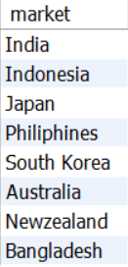
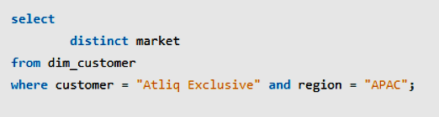
Report for Atliq Hardware
1
Question:
Provide the list of markets in which customer "Atliq Exclusive" operates its business in the APAC region.
Output:
Query:

Slide 4

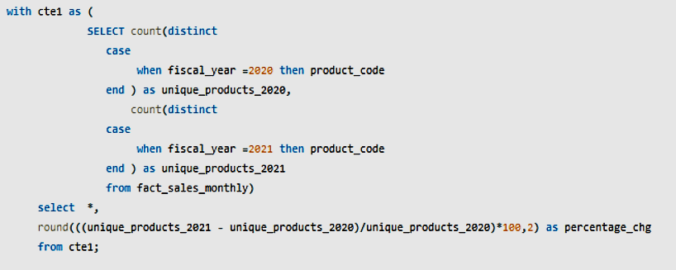
2
Question:
What is the percentage of unique product increase in 2021 vs. 2020? The final output contains these fields,
- unique_products_2020
- unique_products_2021
- percentage_chg
Output:
Query:

Slide 5
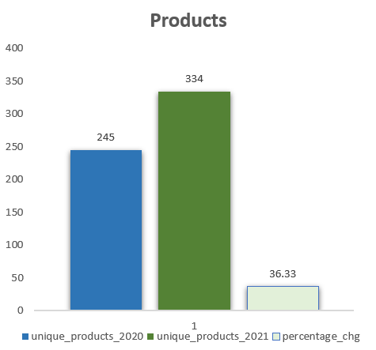
From this visual, we can see a significant increase in unique products offered by AtliQ Hardwares, rising from 245 in 2020 to 334 in 2021—a 36.33% growth. This reflects a strong expansion in their product range within just one year.
2

Slide 6
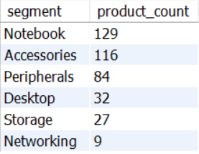
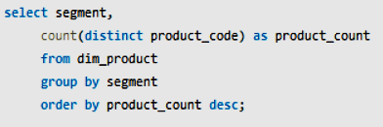
3
Question:
Provide a report with all the unique product counts for each segment and sort them in descending order of product counts. The final output contains 2 fields,
- Segment
- product_count
Output:
Query:

Slide 7
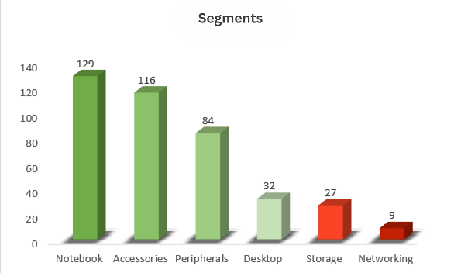
3
This chart illustrates the product distribution at AtliQ Hardwares, showing various segments.
. Notebooks have the largest share with 129 products, followed by Accessories with 116 products, and others.
. The smallest segment is Networking, with only 9 products
Overall
Notebooks and Accessories hold the largest share of the product distribution at AtliQ Hardwares.

Slide 8
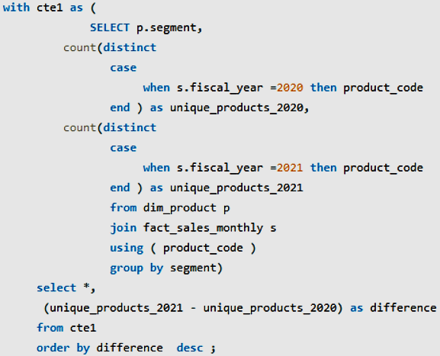
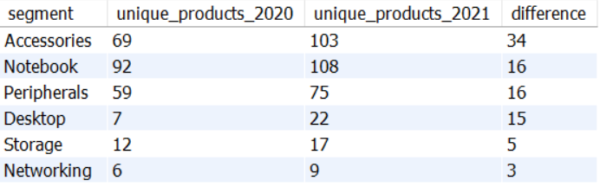
4
Question:
Which segment had the most increase in unique products in 2021 vs 2020? The final output contains these fields,
- segment
- product_count_2020
- product_count_2021 ,difference
Output:
Query:

Slide 9
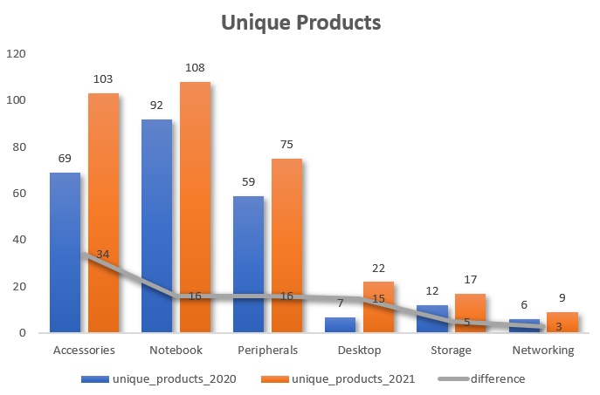
4
All segments experienced an increase in their product counts.
. The Accessories segment saw the most significant growth, with an increase of 34 units, rising from 69 to 103, followed by others.
. However, the Storage segment had a minimal increase of just 5 units, rising from 12 to 17,
. while the Networking segment saw a slight increase of 3 units, moving from 6 to 9.
Overall, the data indicates a positive
trend in product counts across all segments.

Slide 10
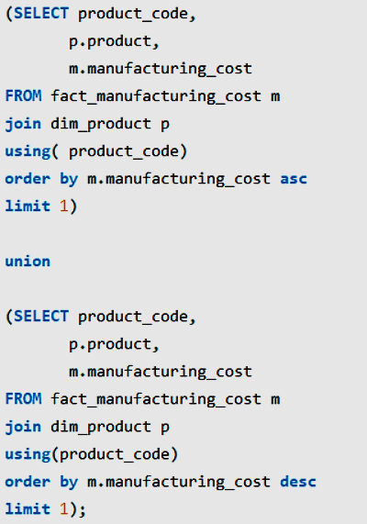

5
Question:
Get the products that have the highest and lowest manufacturing costs. The final output should contain these fields,
- product_code
- product
- manufacturing_cost
Output:
Query:

Slide 11
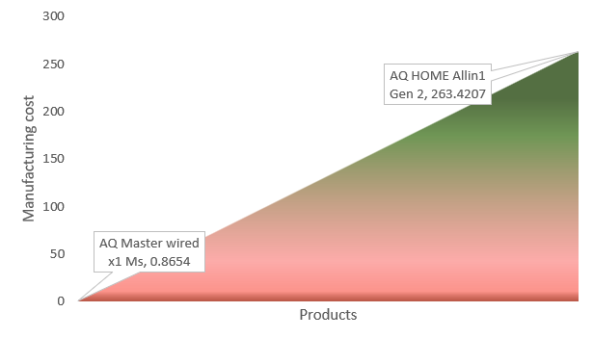
5
. AQ Master Wired x1 Ms has a low manufacturing cost of 0.8654 units and falls under the Accessories category, which means it has a simpler build.
. AQ HOME Allin1 Gen 2 has a much higher cost of 263.4207 units and falls under the Desktop category, indicating a more complex and expensive build

Slide 12
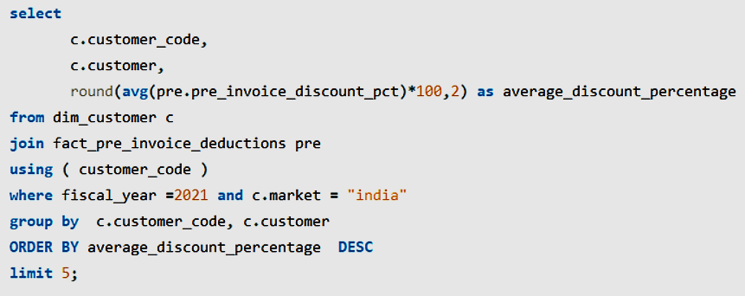
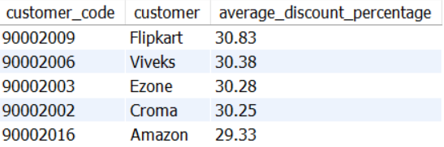
6
Question:
Generate a report which contains the top 5 customers who received an average high pre_invoice_discount_pct for the fiscal year 2021 and in the Indian market. The final output contains these fields,
- customer_code
- customer
- average_discount_percentage
Output:
Query:

Slide 13
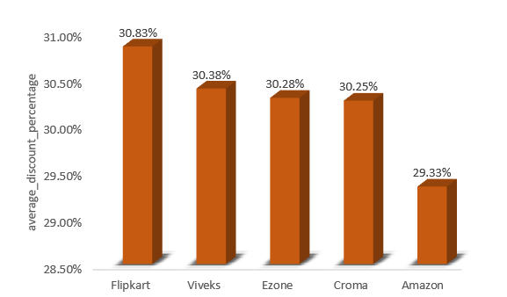
6
. The data shows the discount percentages offered by different retailers in the Indian market.
. Flipkart provides the highest discount at 30.83%, making it the most favourable option for customers seeking maximum savings.
. Amazon offers the lowest discount at 29.33%, indicating relatively fewer savings compared to other retailers. The remaining fall in between, with discount percentages close to 30%.
Overall,
the discount rates are competitive, but Flipkart stands out as offering the highest discount in this market segment

Slide 14
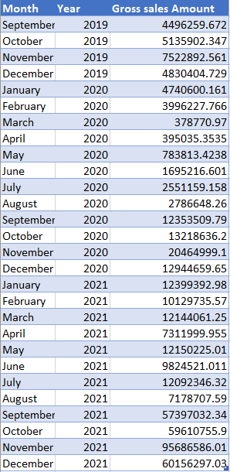
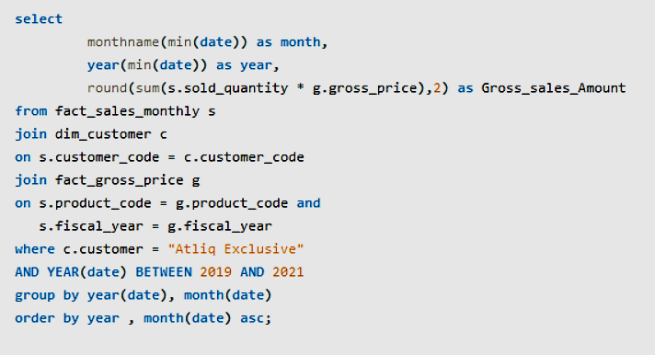
7
Question:
Get the complete report of the Gross sales amount for the customer “Atliq Exclusive” for each month. This analysis helps to get an idea of low and high-performing months and take strategic decisions. The final report contains these:
- Month
- Year
- Gross sales Amount
Query:
Output:

Slide 15
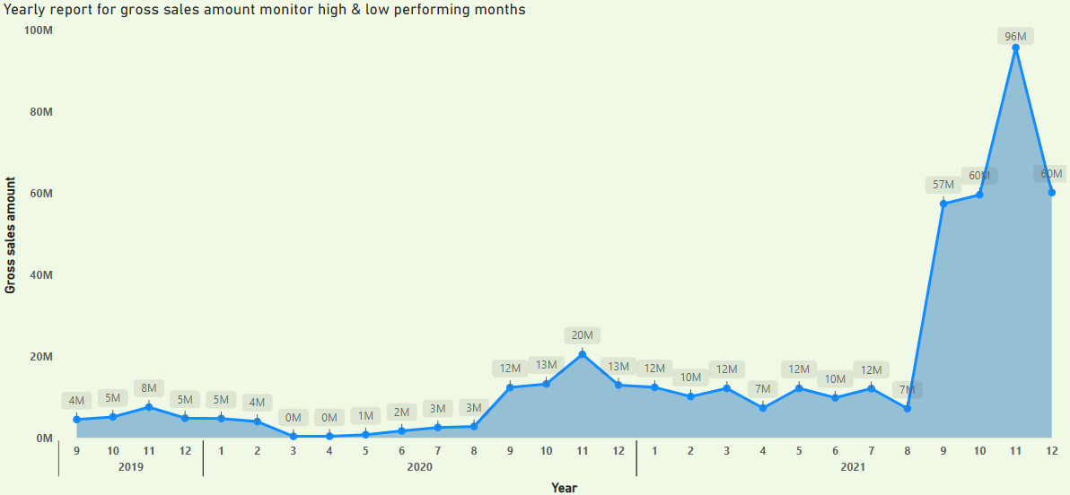
7
. In 2019, November saw the highest sales for that year, while September recorded the lowest.
. For 2020, the peak month was November, which had the highest sales, and March was the month with the lowest sales.
. In 2021, November also had the highest sales, while August recorded the lowest.
Every month in 2021 saw an increase in sales compared to the previous year, indicating strong growth throughout that year, totalling approximately $354.9 million. Additionally, 2020 had the minimum sales, totalling approximately $27.8 million.
Notably, every year shows an increase in sales during the month of November.

Slide 16
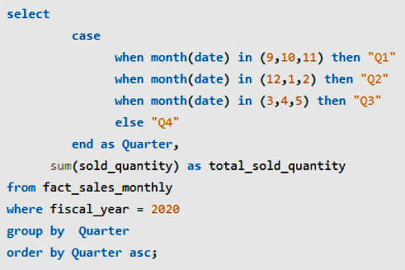
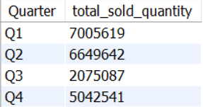
8
Question:
In which quarter of 2020, got the maximum total_sold_quantity? The final output contains these fields sorted by the total_sold_quantity,
- Quarter
- total_sold_quantity
Output:
Query:

Slide 17
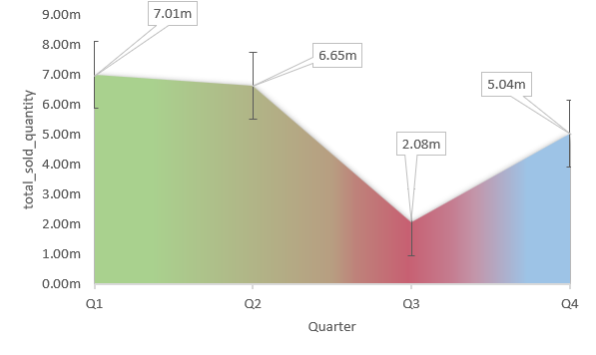
8
. Q1 had the highest total sold quantity at 7.01 million, making it the best-performing quarter.
. Q2 also performed well, with 6.65 million sold. However,
in Q3, there was a significant decline, with sales dropping to 2.08 million, the lowest of all four quarters.
. Fortunately, Q4 showed improvement, as sales increased to 5.04 million.

Slide 18
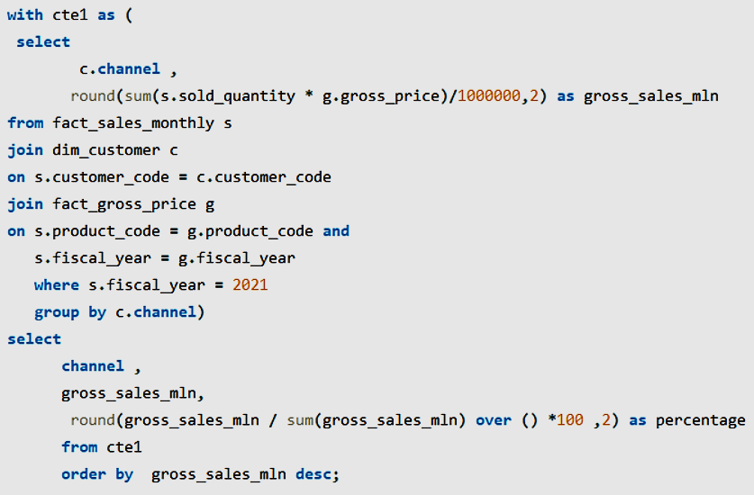
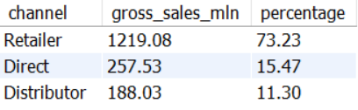
9
Question:
Which channel helped to bring more gross sales in the fiscal year 2021 and the percentage of contribution? The final output contains these fields, - channel - gross_sales_mln - percentage
Output:
Query:

Slide 19
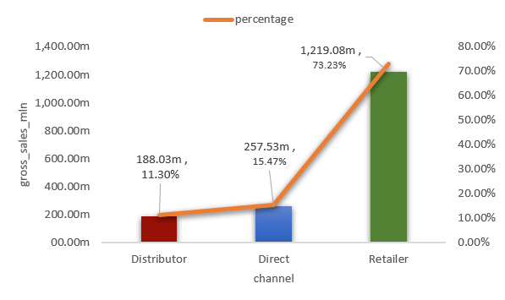
. In the fiscal year 2021, AtliQ Hardware’s report shows that :
. The Retailer channel had the highest gross sales, reaching 1,219.08 million, which made up 73.23% of the total sales.
. The Direct channel recorded 257.53 million in gross sales, contributing 15.47%. Meanwhile,
. The Distributor channel had the lowest sales at 188.03 million, accounting for 11.30% of the total
9

Slide 20
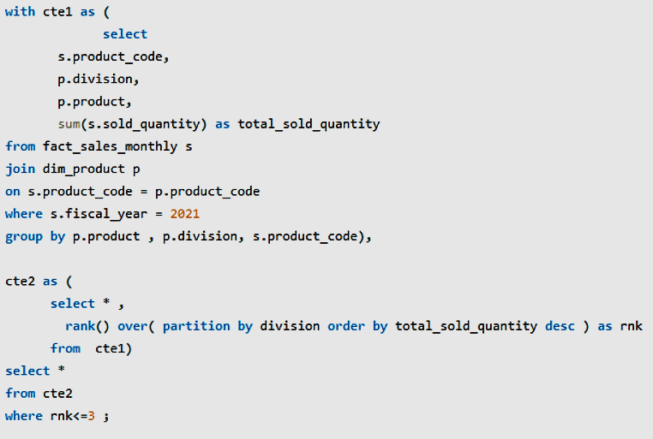
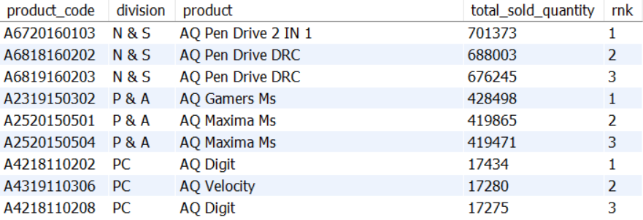
10
Question:
Get the Top 3 products in each division that have a high total_sold_quantity in the fiscal_year 2021? The final output contains these fields,
- division
- product_code
- product
- total_sold_quantity
- rank_order
Query:
Output:

Slide 21
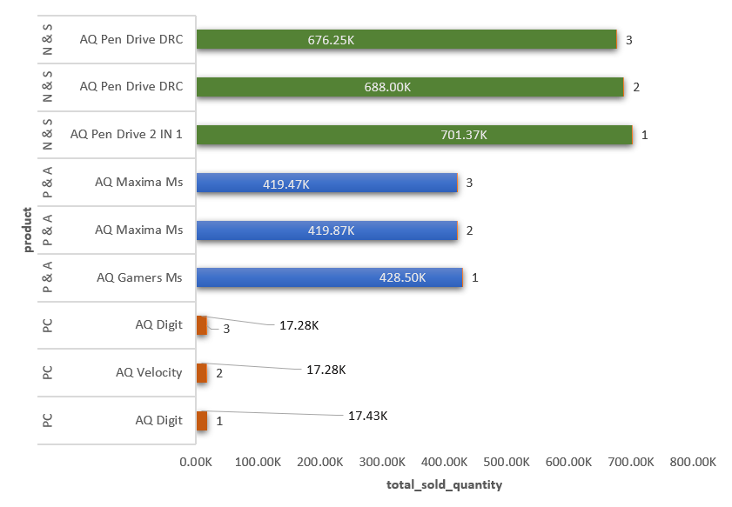
. In the fiscal year 2021, AtliQ Hardware’s report shows that :
From the top three Division
. the AQ Pen Drive 2 IN 1 from the N & S division, with impressive sales of 701.37K, ranking 1st in its division.
. The product with the lowest total sold quantity is the AQ Digit from the PC division, which sold 17.28K units and is ranked 3rd in its division.
10

Slide 22
Thank you

